Slide 1





F
Group
TWITTER US AIRLINE SENTIMENT
Project
Report
See what we're up to

Slide 2



Project Updates
WEEK 2
TASK 1
TASK 2
TASK 3
Collation
Data Cleaning
Data Analysis
STATUS
STATUS
STATUS
99%
50%
26%

Slide 3




Data Set Collation
The data we got from kaggle was incomplete and had a lot of holes in it.
We went through the data and gathered some Information from it and made it usable for out model.
The things we did are:
Classification
Analysis
Cleaning
Patching

Slide 4





Data Set Analysis
Things we found odd
We did some Analysis and found out that there were a lot of unusable values in the data, So we just made it usable.
Steps we took:
First we classified the data and substituted some values that we thought were useful for our calculations.
We filled up almost all the potholes in the data.
and we just used them to do some calculations.

Slide 5
Data Set Analysis
# Column Non-Null Count Dtype
--- ------ -------------- -----
0 tweet_id 14640 non-null float64
1 airline_sentiment 14640 non-null object
2 airline_sentiment_confidence 14640 non-null float64
3 negativereason 9178 non-null object
4 negativereason_confidence 10522 non-null float64
5 airline 14640 non-null object
6 airline_sentiment_gold 40 non-null object
7 name 14640 non-null object
8 negativereason_gold 32 non-null object
9 retweet_count 14640 non-null int64
10 text 14640 non-null object
11 tweet_coord 1019 non-null object
12 tweet_created 14640 non-null object
13 tweet_location 9907 non-null object
14 user_timezone 9820 non-null object

Slide 6
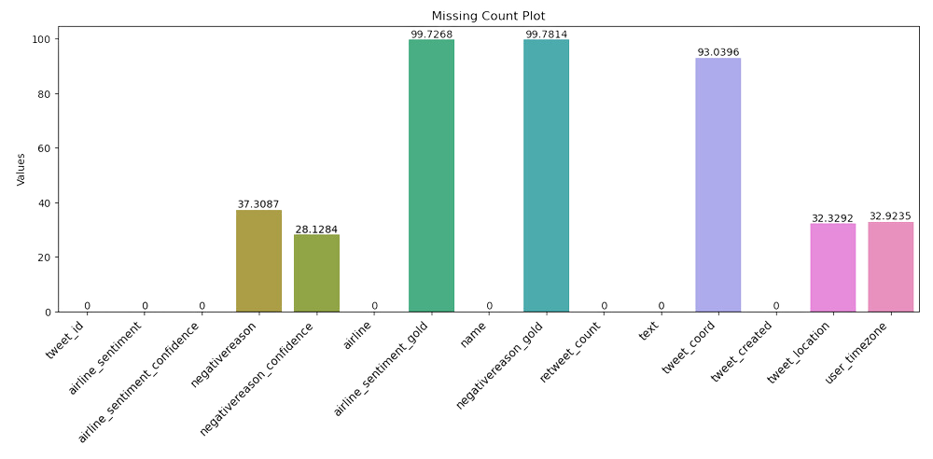
Data Set Counts
There were a lot of missing values in the data set
Dropped airline_sentiment_gold, negativereason_gold , tweet_coord as it has very high rate of missing values present in the data set
Imputed NA and 0.0 into missing value for negativereason and negativereason_confidence as it is data for positive and neutral sentiments
Imputed user_timezone and tweet_location as Other to not miss the Data

Slide 7
Data Description
Taking Some Steps
After making the data usable, we calculated mean, median, top and unique values.
count mean std min 25% 50% 75% max
airline_sentiment_confidence 14640.0 0.900169 0.16283 0.335 0.6923 1.0 1.0 1.0
negativereason_confidence 14640.0 0.458755 0.401057 0.0 0.0 0.6246 0.7033 1.0
retweet_count 14640.0 0.08265 0.745778 0.0 0.0 0.0 0.0 44.0
count unique top freq
airline_sentiment 14640 3 negative 9178
negativereason 14640 11 NA 5462
airline 14640 6 United 3822
name 14640 7701 JetBlueNews 63
text 14640 14427 @united thanks 6
tweet_created 14640 14247 2015-02-24 09:54:34 -0800 5
tweet_location 14640 3082 Other 4733
user_timezone 14640 86 Other 4820

Slide 8
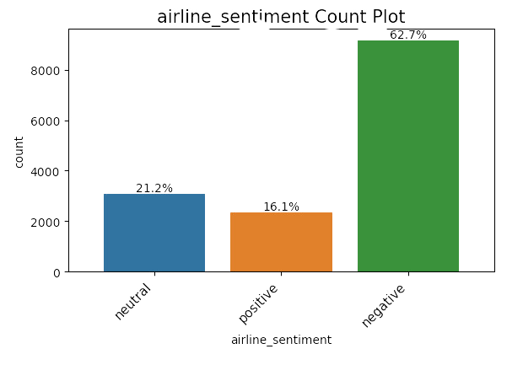
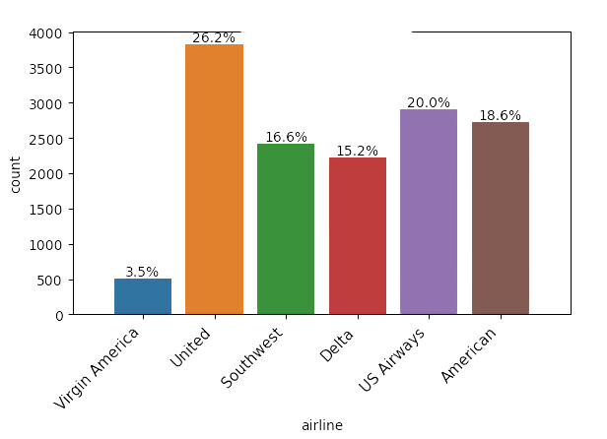
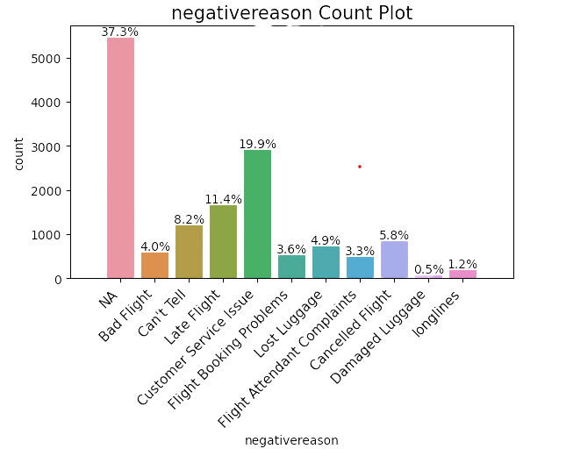
Some more Counts
Airline counts

Slide 9

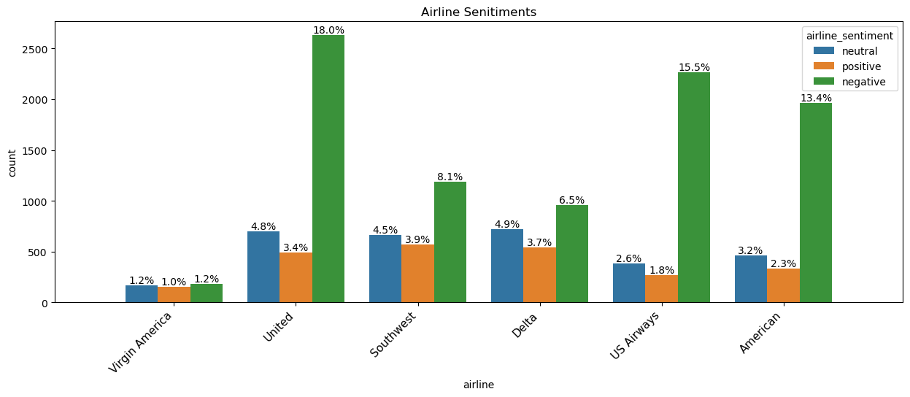

The final count

Slide 10
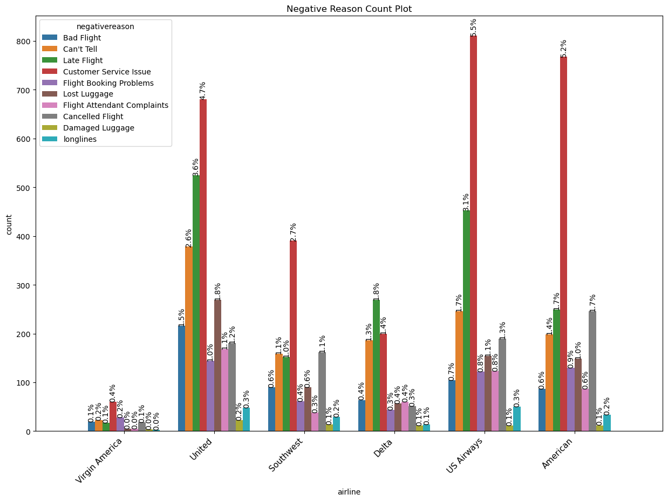

Some other counts

Slide 11
Retweet count
negativereason airline user_timezone retweet_count retweet_count
Bad Flight Delta Eastern Time (US & Canada) 2 1
United Pacific Time (US & Canada) 2 1
Can't Tell American Eastern Time (US & Canada) 4 1
Quito 2 1
Delta Central Time (US & Canada) 3 1
Eastern Time (US & Canada) 22 1
Pacific Time (US & Canada) 18 1
Quito 7 1
Southwest Central Time (US & Canada) 2 1
Eastern Time (US & Canada) 2 1
US Airways Eastern Time (US & Canada) 32 1
United Pacific Time (US & Canada) 3 1
4 2
Cancelled Flight American Eastern Time (US & Canada) 4 2
5 1
Delta Pacific Time (US & Canada) 2 1
Southwest Central Time (US & Canada) 3 1
Eastern Time (US & Canada) 2 3
US Airways Eastern Time (US & Canada) 2 1
United Pacific Time (US & Canada) 2 1
Customer Service Issue American Central Time (US & Canada) 3 1
2 3
Eastern Time (US & Canada) 2 3
4 2
Pacific Time (US & Canada) 2 1
Delta Eastern Time (US & Canada) 2 1
Southwest Central Time (US & Canada) 2 1
Mountain Time (US & Canada) 4 1
US Airways Amsterdam 2 1
Eastern Time (US & Canada) 2 3
United Atlantic Time (Canada) 3 1
Central Time (US & Canada) 2 1
Damaged Luggage US Airways Berlin 4 1
Flight Attendant Complaints United Eastern Time (US & Canada) 3 1
Flight Booking Problems American Eastern Time (US & Canada) 2 1
7 1
United Amsterdam 5 1
7 1
London 4 1
Late Flight Southwest Quito 2 1
US Airways Central Time (US & Canada) 2 1
2 1
Eastern Time (US & Canada) 2 1
44 1
Lost Luggage US Airways Eastern Time (US & Canada) 2 1

Slide 12

Other Updates
We are yet to do some more in depth Calculations and Analysis.
We also have to work on our Data Corrections.
We also have to work on the Imputation.

Slide 13
Our Team
Ajit Atul Kulkarni
Brijalben Panchal
Jonathan Fred Braganza
Nishwinder kaur virk
Parmeet Singh
Vishruti Paresh Avlani
(500223502)
(500224776)
(500223773)
(500224025)
(500224703)
(500224491)

Slide 14


Thank You
Are there any questions?
F
Group

